Slide 1
TOPIC: XAI (Explainable AI)
By Sanjana Asrani, D17B1

Slide 2
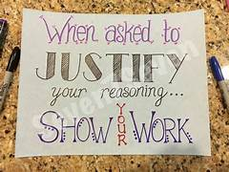
101s of XAI
What is XAI? Answer the WHYs
Need & Objectives
How it works
Challenges & Limitations
Applications

Slide 3
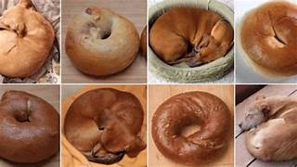
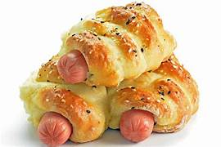
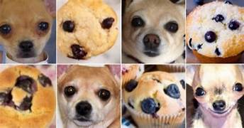
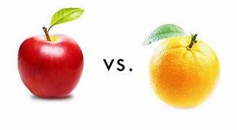
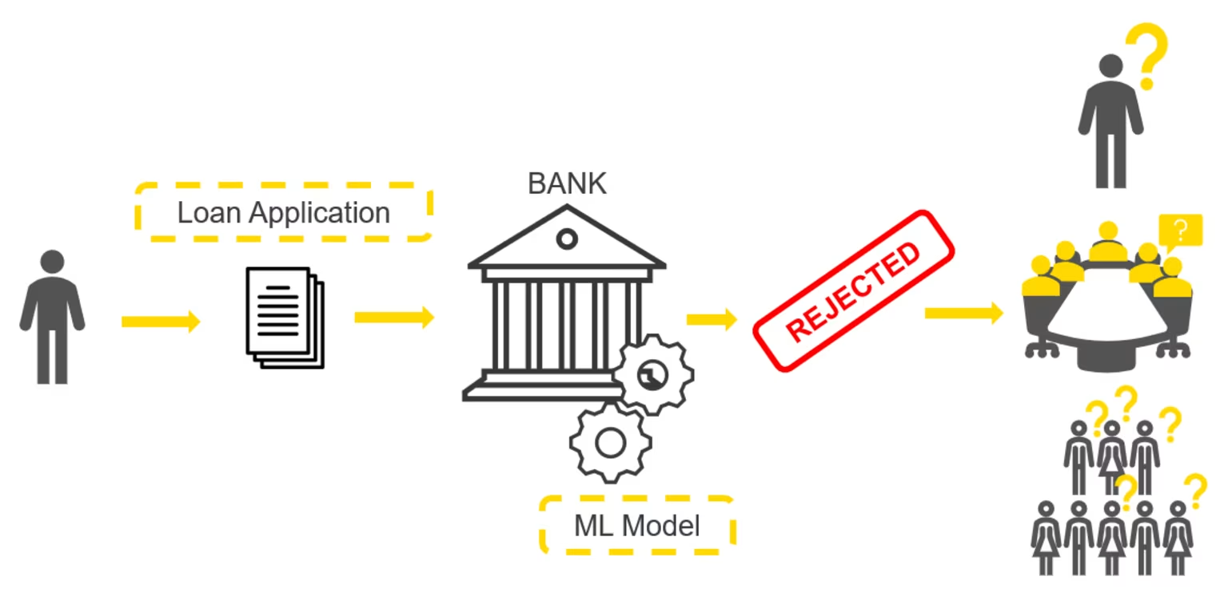
Puppy or a bagel? Why it is what it is?
Credit approval decisions? Why was my Application Denied?

Slide 4
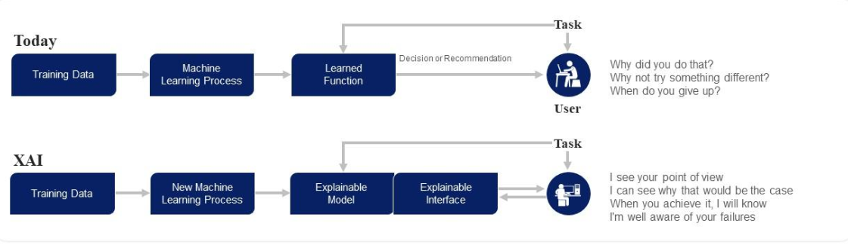
How XAI works

Slide 5
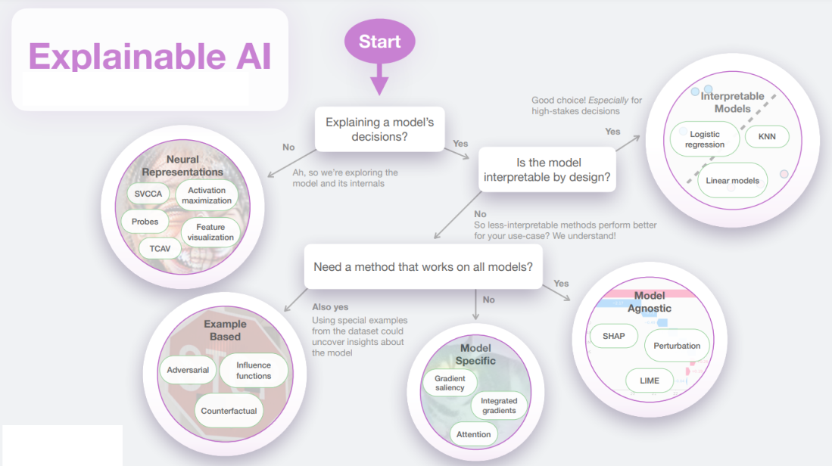

Slide 6
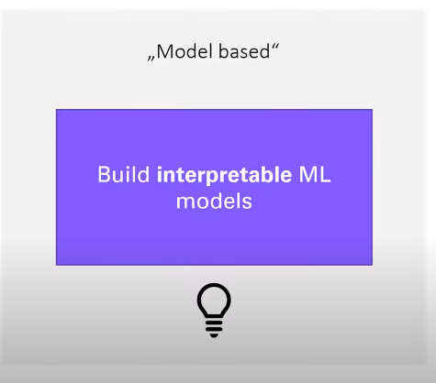
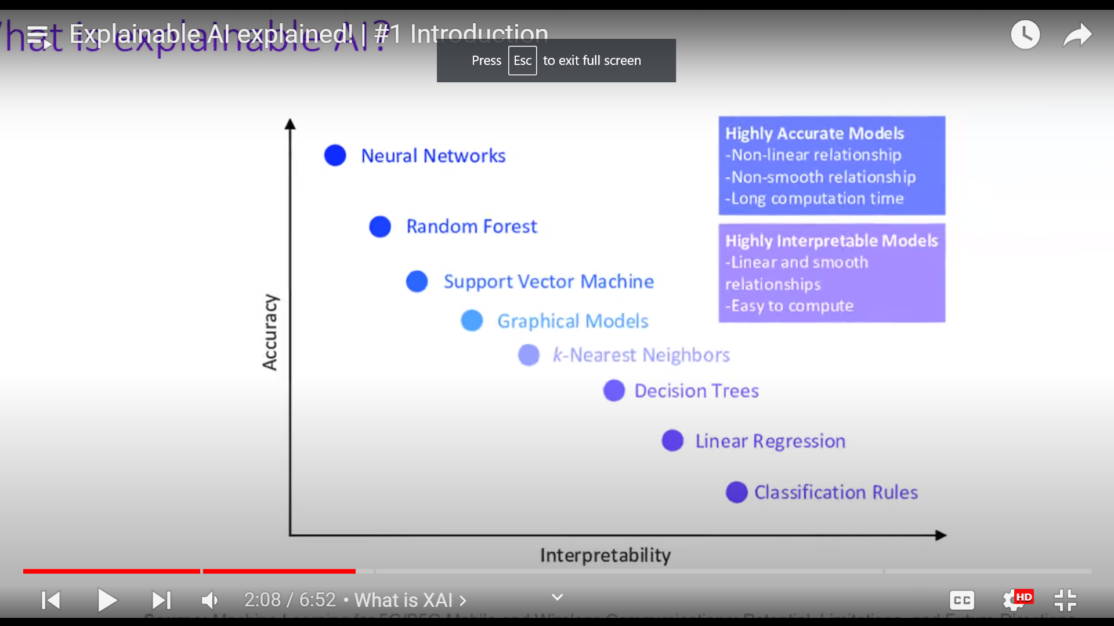
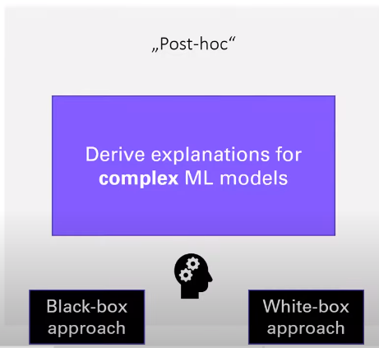

Slide 7
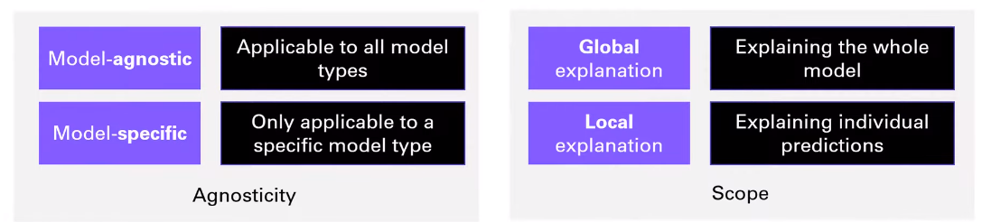
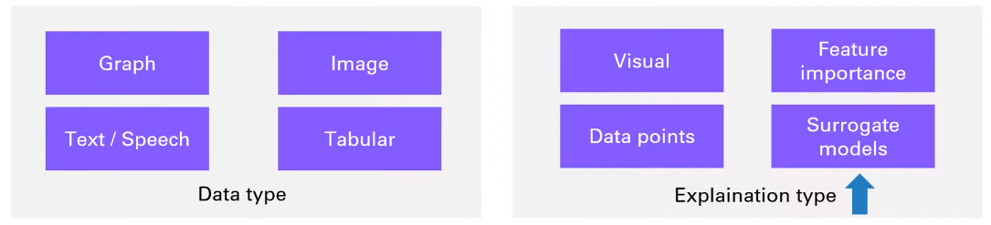
Categorization in XAI:
Complex non linear graphs: Global
Simple Linear: Local

Slide 8
Challenges:
One of the primary challenges in implementing Explainable AI (XAI) is striking the right balance between model interpretability and predictive performance. Highly interpretable models may sacrifice some level of predictive accuracy, which can be a trade-off to consider when choosing an XAI approach.
XAI techniques, especially model-agnostic ones, might encounter challenges when dealing with large and complex datasets. These techniques can be computationally intensive, potentially making them less efficient in certain scenarios.
Limitations:
It's important to note that XAI techniques are not universally applicable to all machine learning models. Model-specific XAI methods are tailored to specific algorithms, which means they may not work seamlessly with all machine learning models. This limitation can impact their versatility.
Furthermore, while XAI can enhance model transparency and provide explanations, it may not fully address ethical concerns or inherently biased data. It's essential to recognize that XAI is one component of broader AI ethics initiatives.

Slide 9
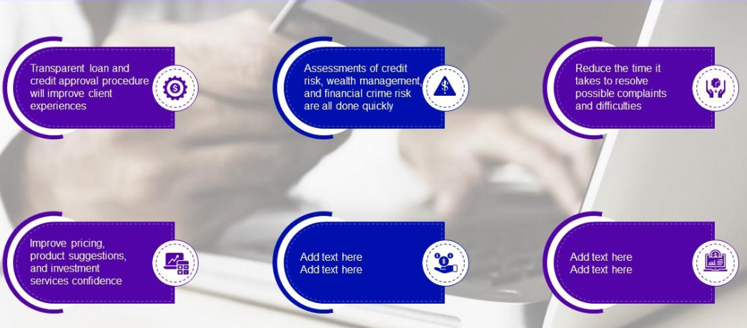
XAI in financial institutions

Slide 10
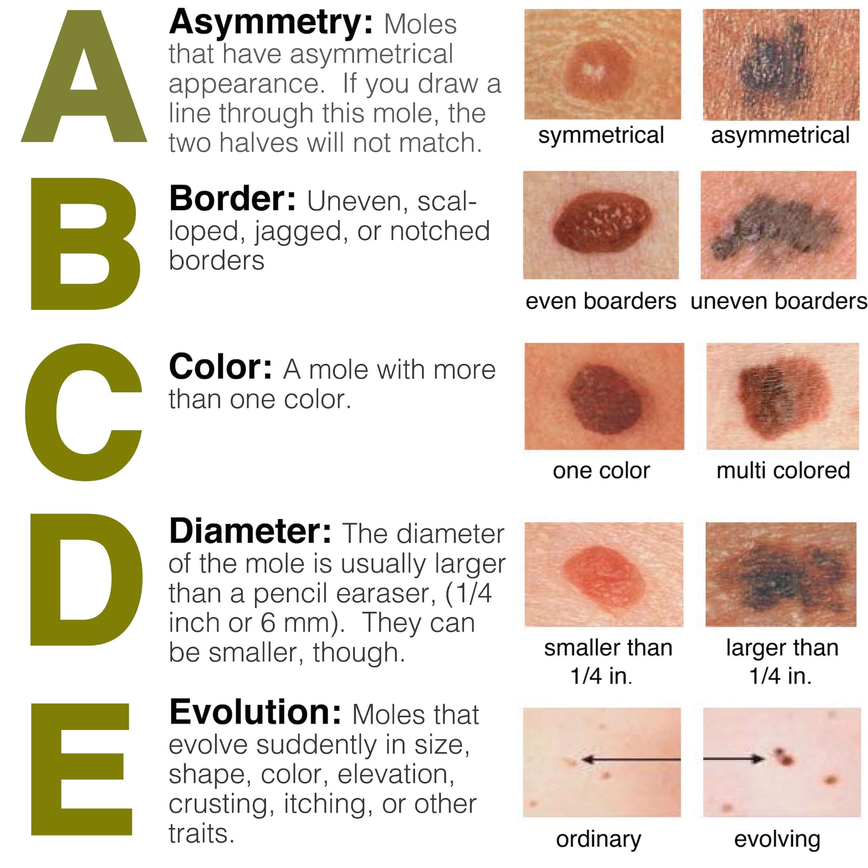
In medical field for diagnosis
7 types of skin cancer, one of them being: Melonoma (Malignant). ABCDE of how to spot it:

Slide 11
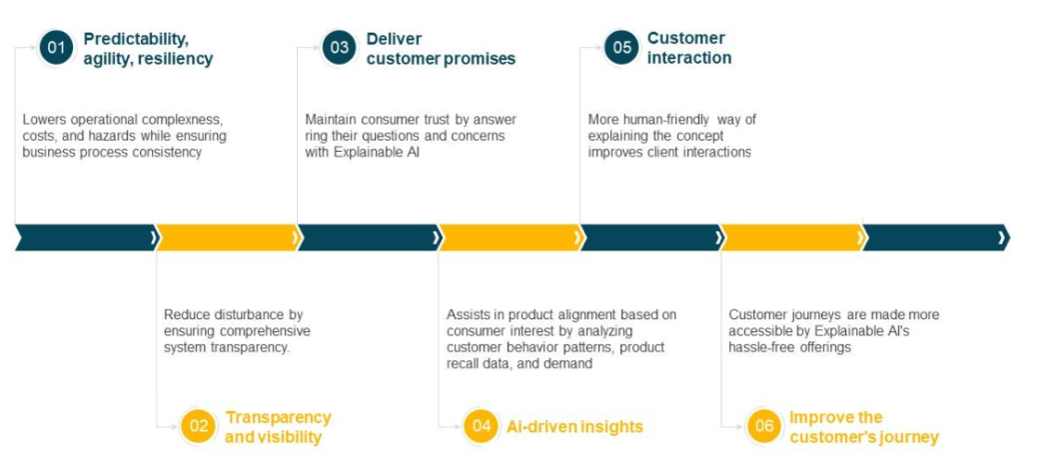
How XAI helps in transforming manufacturing operations:

Slide 12
The ppt has to be concluded because it has already exceeded the max number of slides :)
Any Questions/ Suggestions? Thankyou

